Slide 1
The Merchant of Venice
Answers Act 2

Slide 2
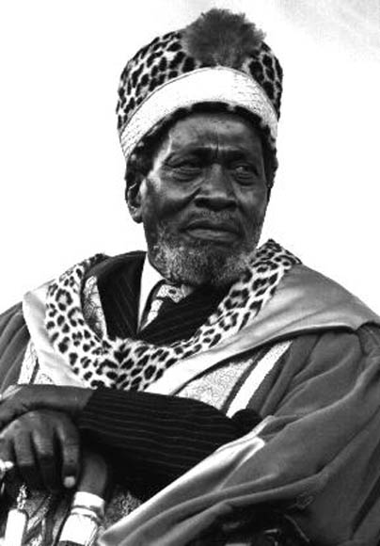
1. Why may Portia not like the way the Prince looks?
He has a dark skin colour

Slide 3

2. How must Portia test whether the Prince is the same as any other man?
She must bring the whitest person she can find in Northern Europe. They must cut the white person and the Prince of Morocco and then they must decide whose blood is the reddest.

Slide 4
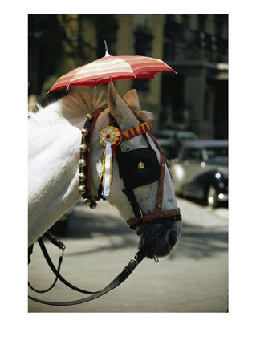
3. Why does Portia not care how he looks?
Her father’s will forbids her to look at the appearance of the men who wants to marry her. If a man chooses the right casket she must marry them, regardless of what they look like.

Slide 5
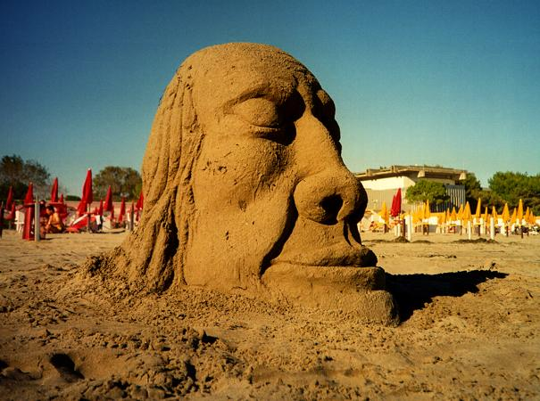
4. How do you know the Prince of Morocco is a brave man?
He has killed many brave men and kings.

Slide 6
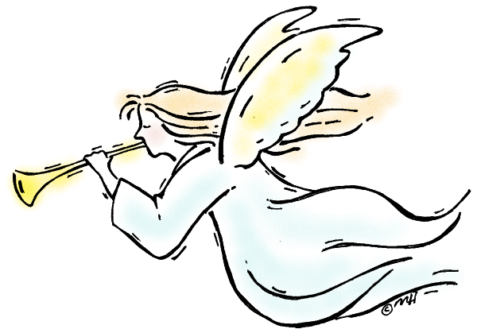
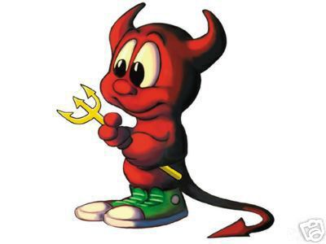
5. Describe the struggle Launcelot has with his conscience?
He can not decide if he should stay with the Shylock or leave Shylock’s service.

Slide 7
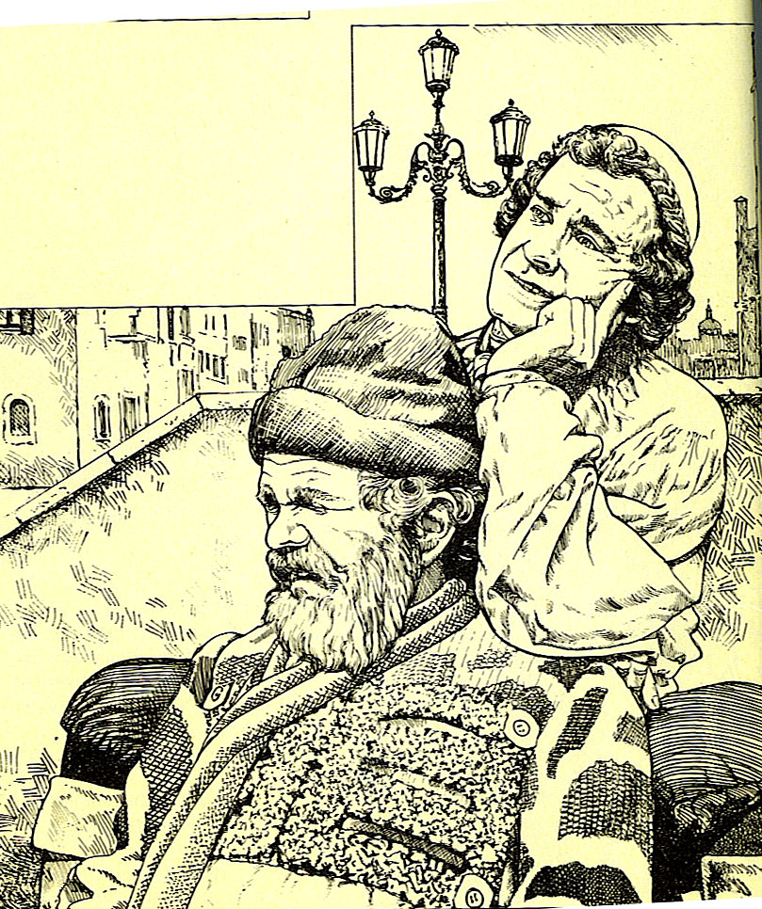
6. Why is it fortunate that Launcelot should meet Gobbo?
His father can now sell him into the service of Bassanio.

Slide 8
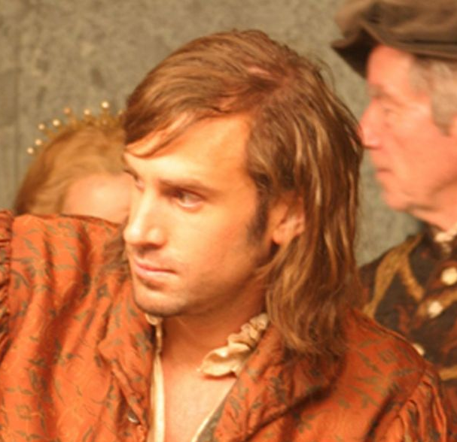
7. Who does Launcelot want to work with?
Bassanio

Slide 9
8. Why doesn’t Bassanio want Gratiano to go with him to Belmont?
Gratiano is too wild, rude and he has a loud voice. He will upset the people of Belmont.

Slide 10
9. How does Jessica feel about her father and about living in his house?
She is ashamed of her father.
Shylock’s house is like hell to her.

Slide 11
10. Who is Jessica in love with and why would Shylock not accept it?
Lorenzo.
Lorenzo is a Christian. Jewish daughters never marry Christian men.

Slide 12
11. What is the message that Lorenzo receives from Jessica?
She tells Lorenzo how he must take her from her father’s house.
She says which jewels she will take with her.
She also says how she will be dressed.

Slide 13
12. Where is Shylock going?
Bassanio invited him for dinner.

Slide 14
13. List the things Shylock trusts his daughter with?
His keys
His house

Slide 15
14. Why does Launcelot mention that his nose bled the other night?
A bleeding nose is a sign that something strange is going to happen.
Shylock may think Bassanio is planning something.
Shylock will make sure he attends the dinner.

Slide 16
15. Why is it strange that Lorenzo should be late?
A lover should be eager to arrive at the appointment he has with his beloved.

Slide 17
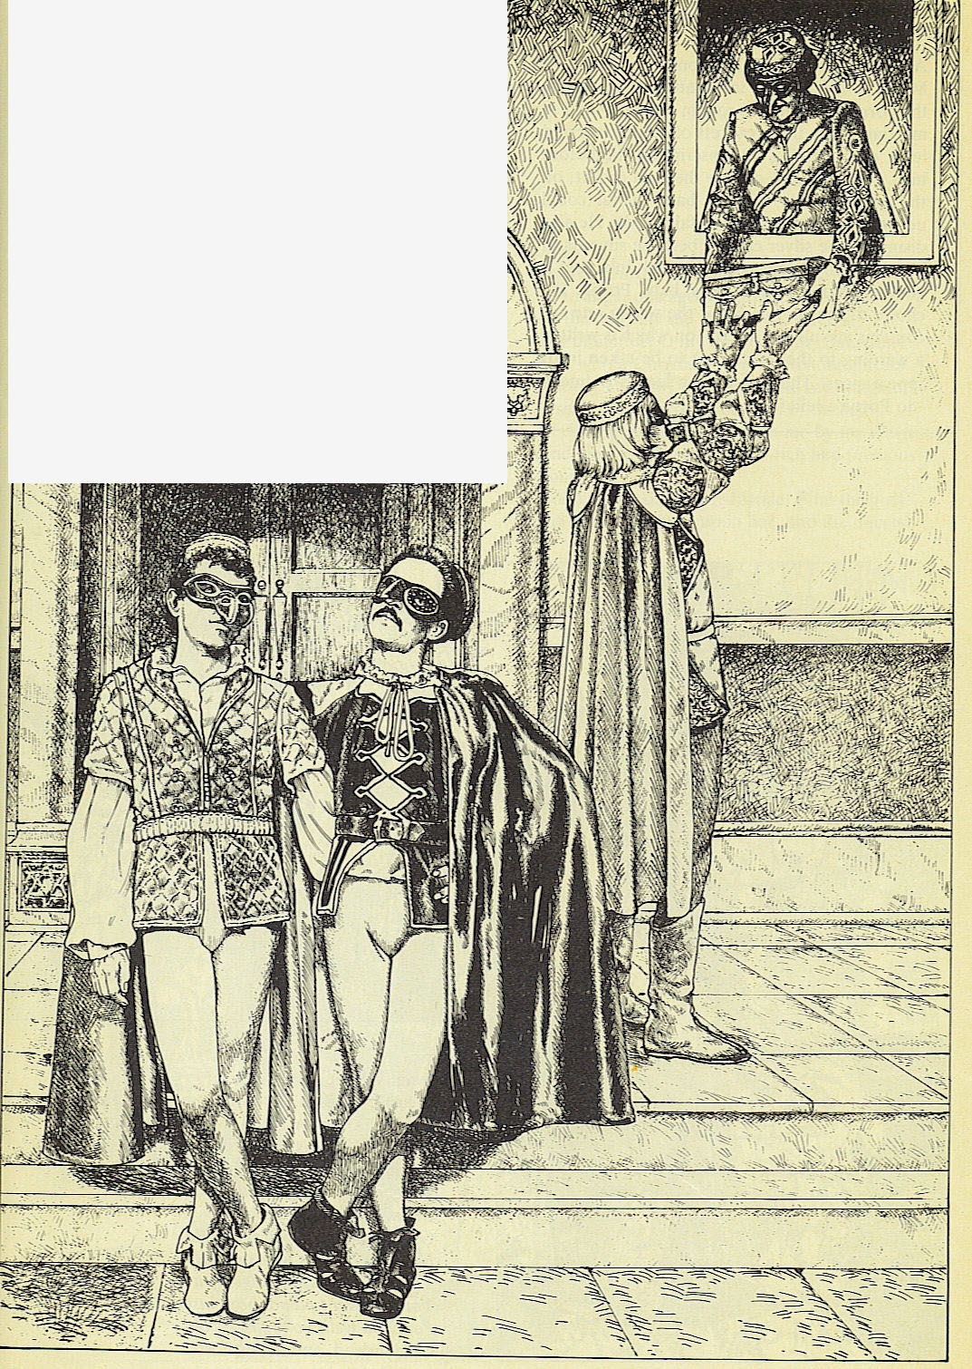
16. What does Jessica take with her when she elopes with Lorenzo?
Ducats, gold and jewels.

Slide 18
17. How does Jessica leave without being recognised?
She is dressed like a boy who carries Bassanio’s torch.

Slide 19
18. What news does Antonio bring Gratiano?
Bassanio’s ship is ready to sail for Belmont. They are only waiting for Gratiano.

Slide 20
19. What does the Prince of Morocco think the lead casket mean?
The casket is a threat.
It asks you to risk all you have for a woman.

Slide 21
20. What does the Prince of Morocco think the silver casket mean?
He thinks he deserves Portia but maybe Portia deserves more.

Slide 22
21. Why does he choose the golden casket?
He thinks the whole world desires Portia.
Portia’s picture also deserves to be stored in gold.

Slide 23
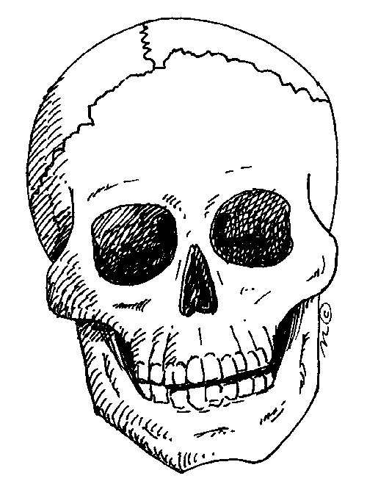
22. What does he find in the casket?
A skull with a note in it’s eye.

Slide 24
23. What did Shylock do when he discovered Jessica was gone?
He woke up the governor and ordered that Bassanio’s ship be searched.

Slide 25
24. Why did he suspect Antonio and Bassanio to be involved in Jessica’s elopement?
Lorenzo was a friend of Bassanio and Antonio.

Slide 26
25. Why must Antonio now hope that his ships come back within three months?
Shylock will make Antonio pay.
Shylock has more reason to be angry with Antonio.

Slide 27
26. What last message did Antonio give Bassanio when he left?
Bassanio does not have to return quickly.
Bassanio must not even think about the contract between Shylock and Antonio.
Bassanio must show Portia all the love he could and he must focus on marrying Portia.

Slide 28
27. What oath must the Prince of Arragon make before he chooses a casket?
He may never tell anyone which casket he has chosen.
If he chooses incorrectly he may never ask another woman to marry him.
He must leave immediately if he chooses wrong.

Slide 29
28. Why does the Prince of Arragon choose the particular casket?
He would not choose what many men desire and Portia must be much more attractive before he chooses to risk all he has for her.
He will choose what he deserves, he will not pretend to be what he is not.

Slide 30
29. What does he find in the casket and what does it mean?
The picture of a clown.
The one who chooses this casket will always be a fool.

Slide 31
30. Who is announced at the gate?
The arrival of a rich Venetian who was there before.

Slide 32
31. How do you know Bassanio made a great impression at the gate?
The servant can not stop talking about all the rich gifts that Bassanio brought with him.

Slide 33
32. Do you think it will bother Portia if she finds out Bassanio is poor?
Maybe, maybe not.

